Slide 1

CSYE6225 NETWORK STRUCTURE & CLOUD COMPUTING “CLOUD9” DECEMBER 2016
Guided By: by:
Prof. Julian cooper Achal Sancheti
Bhavesh Patel
Saurabh ChOUdhari
Srilaya Yallapragada
Sumit Deshmukh

Slide 2
Northeastern Bank
Online Banking Portal for Customers, Employees
AWS Deployment
High Availability
On Demand Scalability
https://northeasternbanking.com
http://vpc.northeasternbanking.com
Test server 1
Test Server 2

Slide 3
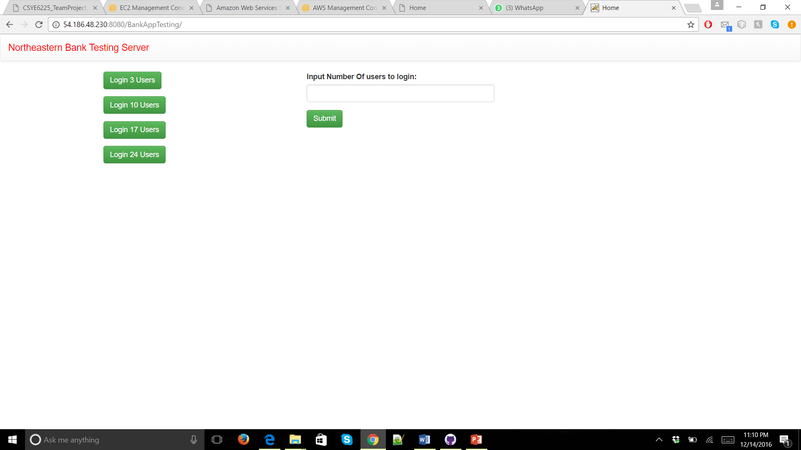
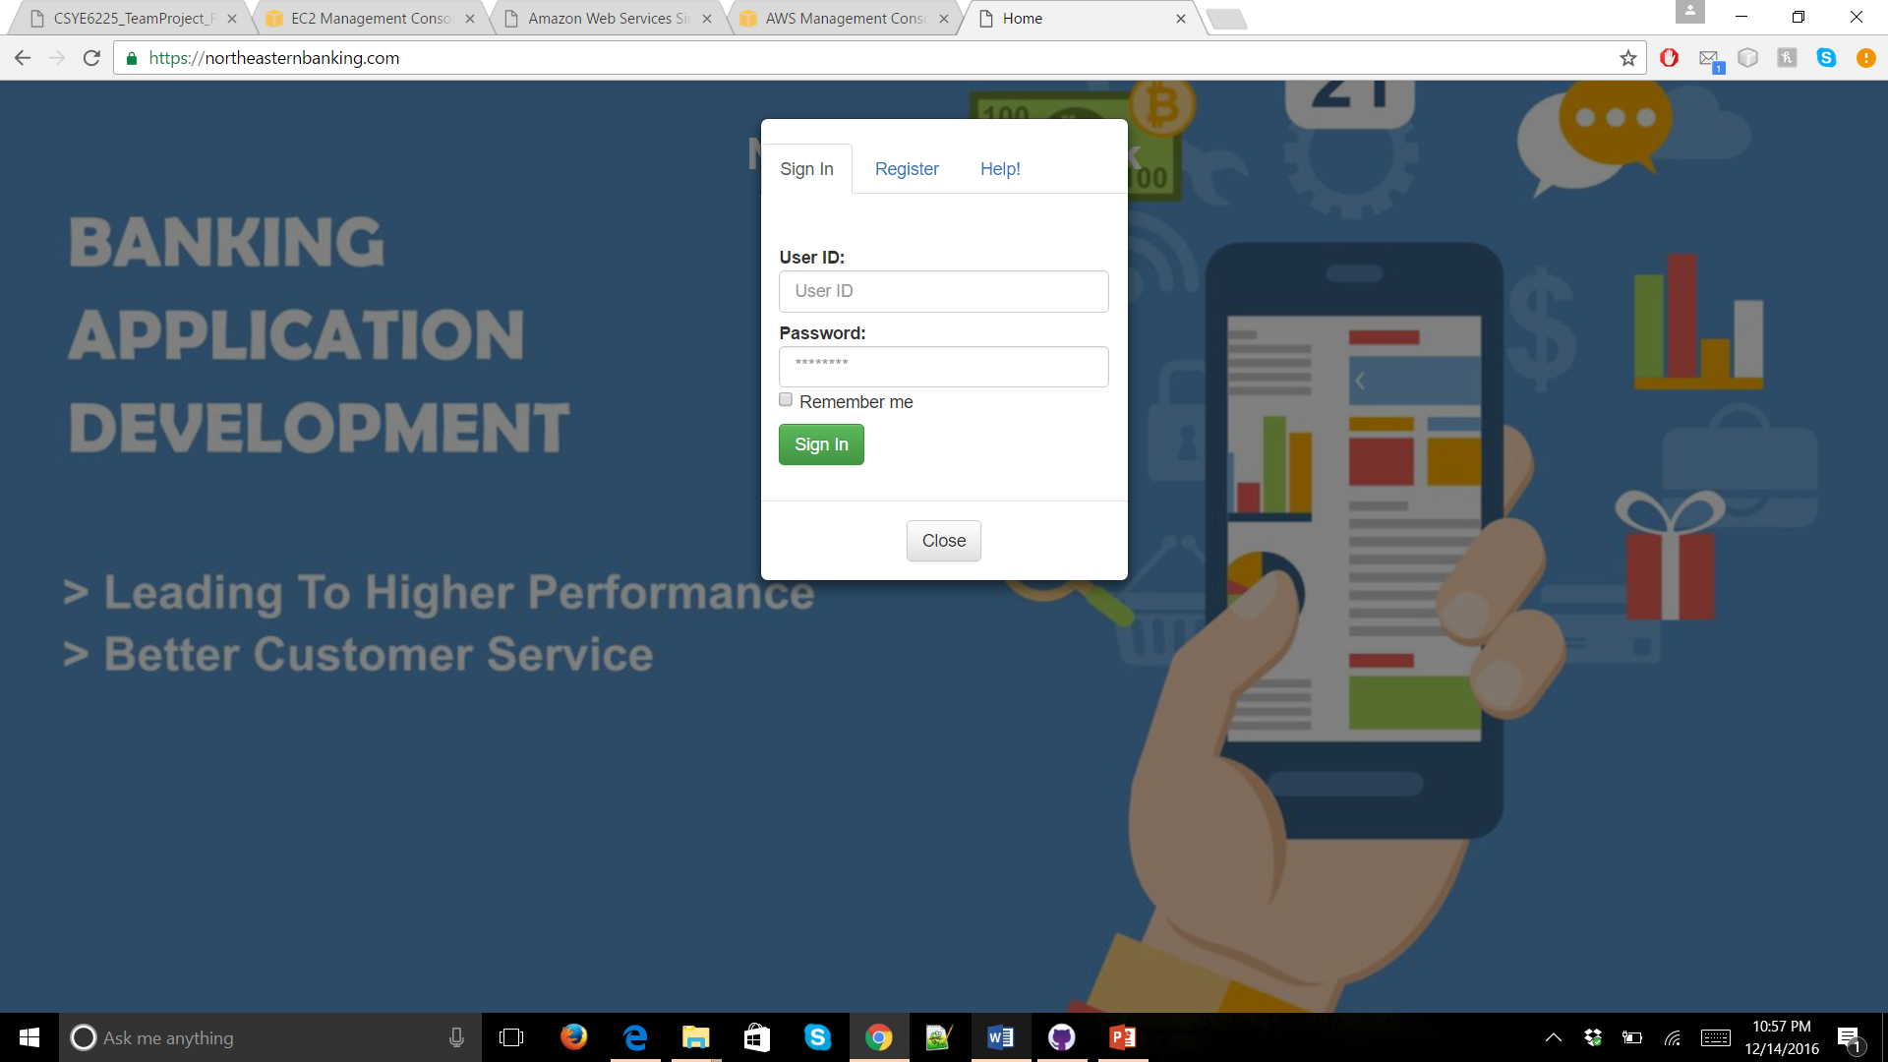
Web Application

Slide 4

Technologies Used
Maven
Tomcat
Spring MVC
Hibernate
RDS
EC2
Elastic Beanstalk
Route 53
ACM
Cloud Watch

Slide 5
Cloud Architecture
VPC with Public and Private Subnets
Primary and Standby Infrastructure
Route53
SSL Encryption
Load Balancer for intelligent routing of load
Auto Scaling Groups
AWS RDS with multi-AZ deployment
Security Groups, Alarms and Cloud Watch Logs

Slide 6
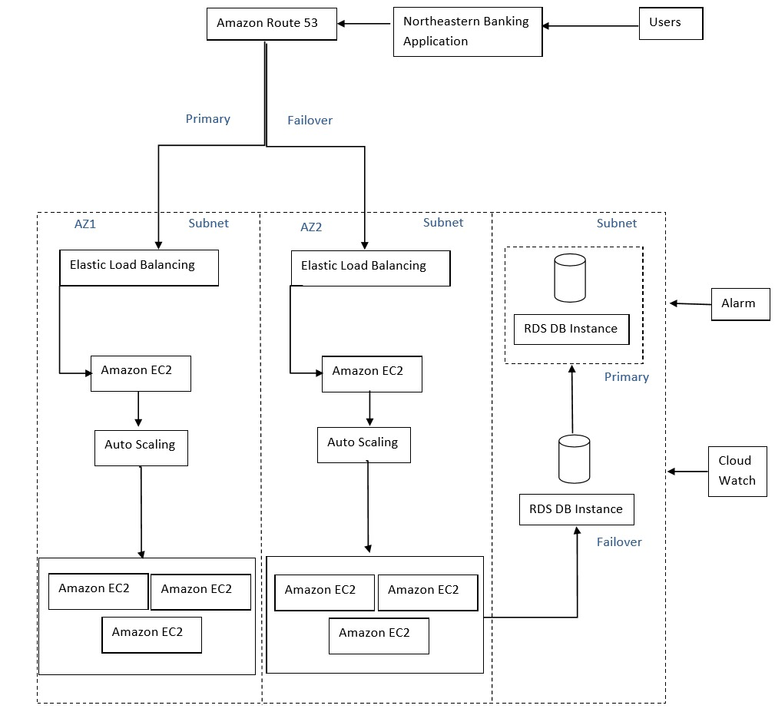
Read Replica of RDS
US-East-Virginia
Primary Infrastructure
US-West-Oregon
Standby Infrastructure
US-West-Oregon
Multi AZ deployment of RDS

Slide 7
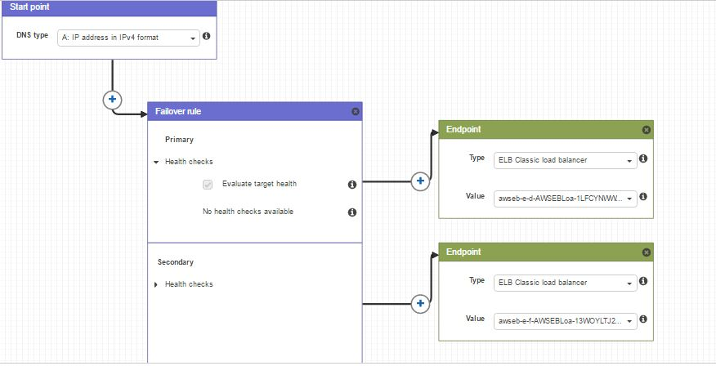
Fail-oVer Plan
In case failure Route 53 switches to use standby infrastructure

Slide 8
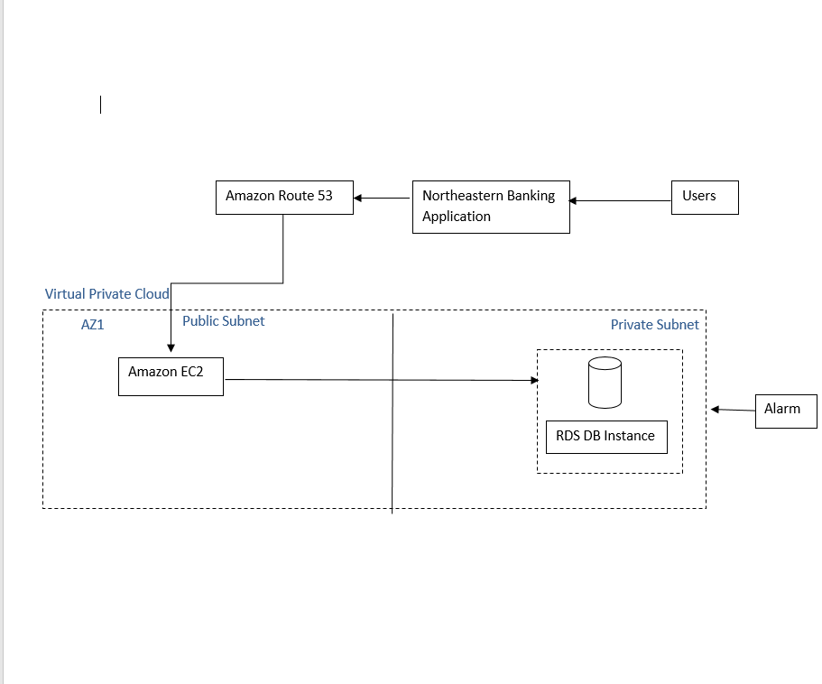
VPC INFRASTRUCTURE (Scope of Improvement)

Slide 9
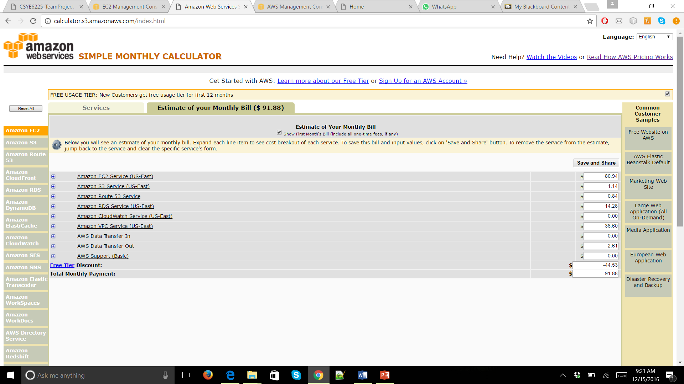
Cost / Performance per 1000 Customers

Slide 10
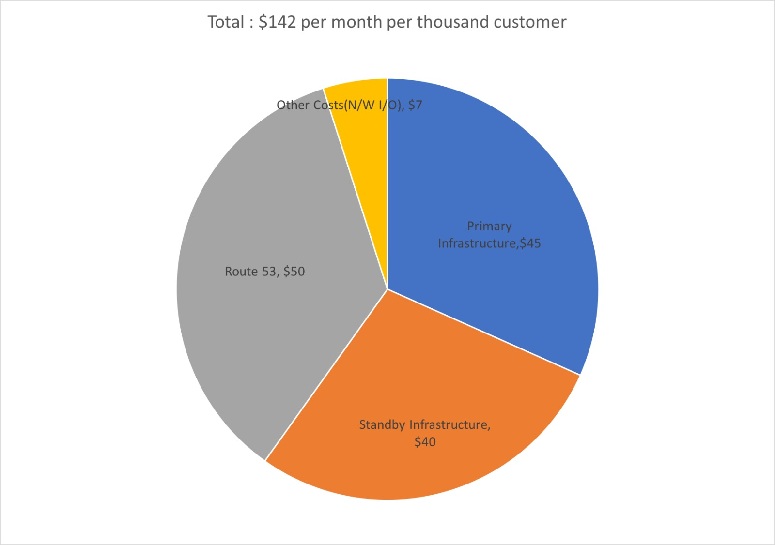
High Availability Pricing Model per Month
Misc. Costs per year: Domain and certificate renewal fees : $ 50
Total 6 month cost: 852$

Slide 11
Disaster Recovery
Full Backups daily
Fail-Over Infrastructure in case primary infrastructure fails
Cloud Formation using Template of the infrastructure

Slide 12
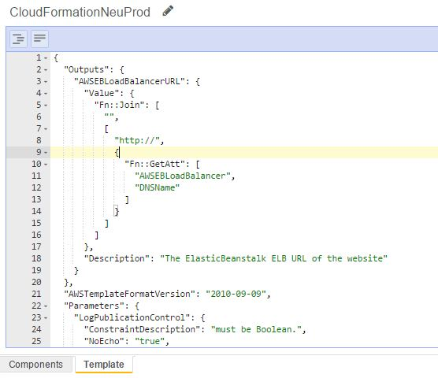
Cloud Formation
Whole deployed infrastructure in a JSON text file
Can be used for version control and tracking changes
In case of disasters whole infrastructure can be brought up in few minutes

Slide 13
Challenges
Exploring Financial Application Deployment on cloud
Handling Security Issues
Using Load Balancer inside VPC
Fail Over traffic routing in Route 53
Routing traffic Automatically from HTTP to HTTPS (Not Implemented)

Slide 14
references
https://aws.amazon.com/documentation/
http://whatiscloud.com/
http://searchcloudcomputing.techtarget.com/definition/cloud-computing

Slide 15
Thank you
https://northeasternbanking.com
http://vpc.northeasternbanking.com
Test server 1
Test Server 2

